Slide 1







English File Pre-intermediate (4th Edition)
UNIT 1B:
THE PERFECT DATE?
Listening Skills Focus: Analyzing Relationships & Personality

Slide 2

OBJECTIVES:
By the end of the lesson, students will be able to:
I. Knowledge
  recognize and understand words describing personality and appearance (related to dating).
  identify the use of the Present Simple tense in character descriptions.
II. Competence
  Identify and comprehend core vocabulary describing personality and appearance
  Recognize the application of the Present Simple tense in conversational descriptions.
III. Personal Qualities
  participate actively and cooperate in group analysis tasks
  cultivate respect for diversity in viewing and analyzing relationship preferences and personality types

Slide 3




PROCESS
01
02
Warm-up
Pre-listening
03
04
05
While-listening
Post-listening
Consolidation

Slide 4






I. WARM-UP
Who is faster?
Aim: To immediately capture student interest, introduce the lesson's theme non-academically, and create an aesthetically engaging start using multimedia.

Slide 5
I. WARM-UP
Who is faster?
The class is divided into 3 group
You will see some famous or fictional couples on the screen.
When you know who they are — raise your hand and say their names in English and describe what makes them a perfect match.
Example: “Beauty and The Beast, they love each other because they are kind and loyal.”

Slide 6
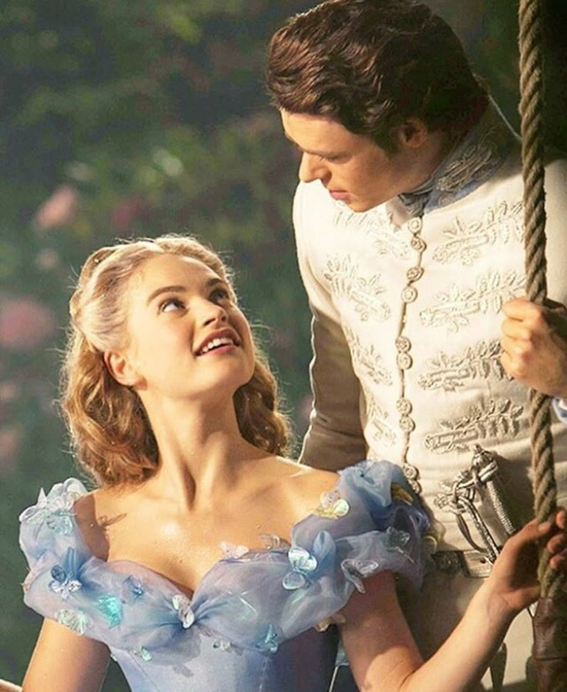
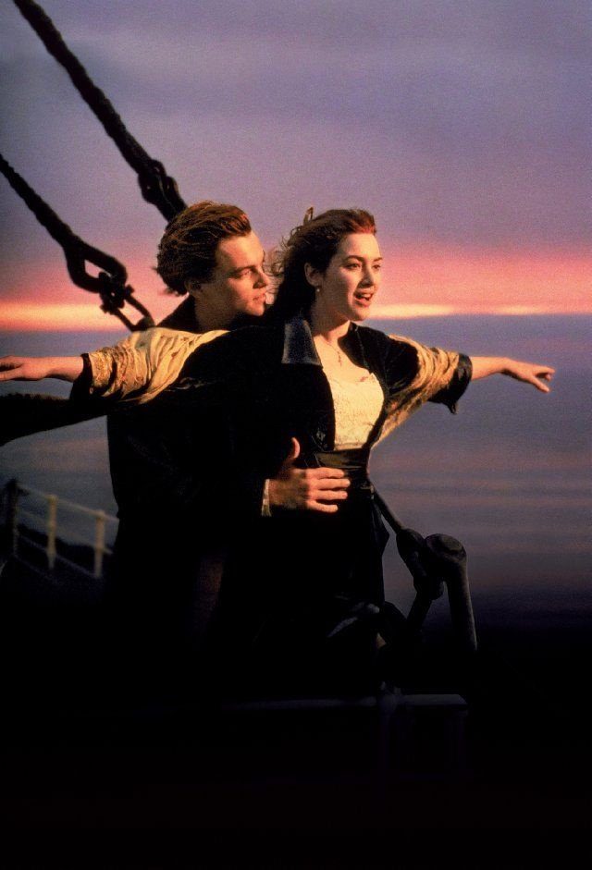
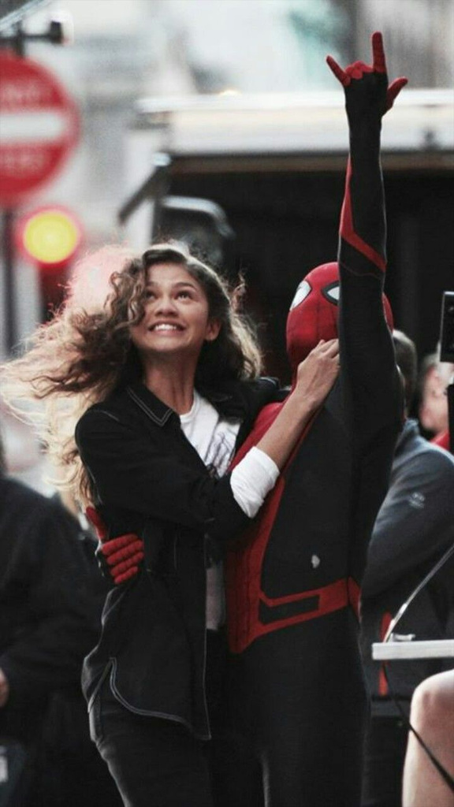
Look at the following pictures and guess Who are they?

Slide 7
Look at the following pictures and guess Who are they?
Cinderella & Prince Charming
Jack and Rose
Peter Parker & MJ/ Tom Holland & Zendaya (Spiderman)
(Titanic)

Slide 8
Name 3 adjectives or nouns that describe your "Perfect Date" (places, characteristics, foods, condition,...) on Mentimeter
Room code: 31402387
Notes:
* Link host: https://www.mentimeter.com/app/presentation/ala2ifdgy58enrzrzttteg6b51k2pcy5/edit?question=kouv1bfac414

Slide 9








II. PRE-LISTENING
VOCABULARY BANK: DESCRIBING PEOPLE (PAGE 150)
Aim: To activate students' existing vocabulary and schema related to personality and relationships, ensuring they are linguistically prepared for the listening task, and to collect predictive data via digital tools.

Slide 10
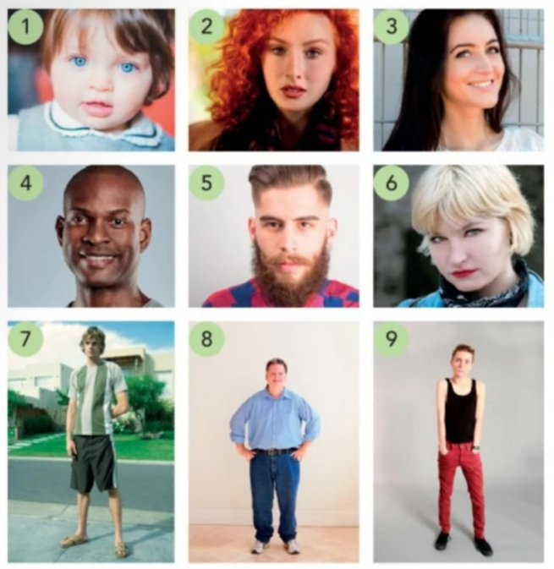
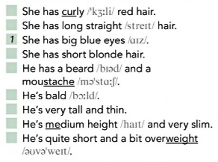

TASK 1: APPEARANCE
What does he/she look like?
a. Match the sentences and photos.
b. Listen and check.

Slide 11
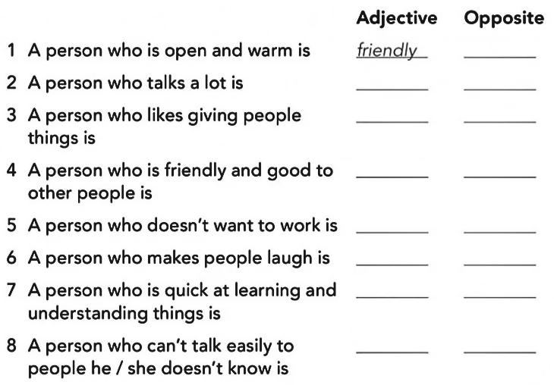
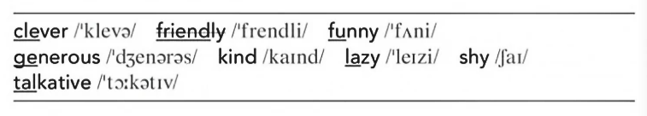
TASK 2: PERSONALITY
What’s he/she like?
a. Match the adjectives to the definitions.

Slide 12
III. WHILE-LISTENING
Aim: To guide students through structured listening tasks (Gist and Detail), provide immediate formative feedback, and allow the teacher to personalize the learning process by targeting specific errors.

Slide 13

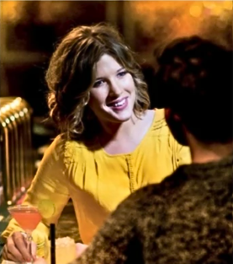
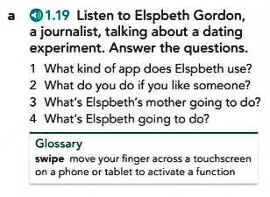
Task a. Listen to Elspbeth Gordon, a journalist, talking about a dating experiment. Answer the questions.

Slide 14
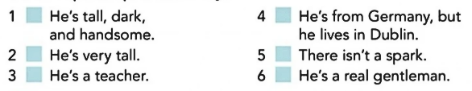
TASK B. Now listen to Elspbeth describe her first two dates.
What does she think of her mom’s choices?
TASK C. Listen again and match the phrases to the two men.
Write J for John or S for Sebastian. Which man do you think Elspbeth prefers? Why?

Slide 15

TASK D. Now listen to the third date. Is it success? Who do you think the message is from?
TASK E. Listen. Were you right? How does Elspbeth feel? Do you think they have a second date?

Slide 16

IV. POST-LISTENING
Aim: To move beyond literal comprehension by training students to infer attitude, synthesize information gathered throughout the entire audio, and apply their understanding to a problem-solving task, fostering collaborative communication.

Slide 17

DISCUSSION
Task 1: Work in group and give your view on Padlet about:
  Based on what you heard about John, Sebastian, and Elspbeth’s attitude, act as Elspbeth’s relationship advisor
  Give 3 specific and unique pieces of advice
  Use personality vocabulary and the Present Simple tense
  After finishing, read other group’ advices and click “like” on the comment you find most convincing
The QR Code of the Padlet discussion board
Notes:
Link host: https://padlet.com/01636722286nem/el-unit-1b-some-advice-for-elspbeth-xkyt656ttzjjvkwt

Slide 18
DISCUSSION
Task 2: Work in pair and present your opinion about:
  Do you think a member of your family could choose a good date for you?
  Do you think you could choose one for them?

Slide 19

V. CONSOLIDATION
  Aim: To quickly review and reinforce key linguistic points (vocabulary/grammar), administer a final summative check via a digital Exit Ticket to measure final comprehension and inference ability, and efficiently assign follow-up application tasks (homework).

Slide 20
V. CONSOLIDATION
Wrap up
  What have you learnt today?
  How confident are you in your listening skills after this lesson? (on a scale of 1 to 5)

Slide 21



HOME WORK
  "My Ideal Classmate Profile" – Write 75 words describing a classmate, using at least 5 adjectives and the Present Simple tense.
  Prepare for the next lesson: 1B- Speaking & Writing (page 9)

Slide 22

THANK YOU
THANK YOU

